Slide 1
AIDTE(Autonomous Intelligent Decision Token Engine) Co-innovation platform
A Co-Creation and Win-Win Ecosystem Based on NFT Technolog
2025/04/07
By CDAO

Slide 2
AIDTE Co-innovation platform
Agenda
1
2
3
4
Cover
Agenda
Our Solution
AIDTE vs. DAO
5
6
7
8
Key Features
Our Roadmap
Our Team
Summary

Slide 3
AIDTE Co-innovation platform
A Co-Creation and Win-Win Ecosystem Based on NFT Technolog

Slide 4
AIDTE – Our Proposition
Collaboration and Co-Creation
One-click Operation
Tokenized Incentives
Decentralized Decision-Making

Slide 5
Our Solution
Resolving The Three Major Pain Points in the NFT Space

Slide 6
Current Problem
Lack of NFT Liquidity
NFT Ownership is Concentrated, Lacking Co-Creation and Win-Win Mechanisms
NFTs Lack Operational and Governance Frameworks

Slide 7
AIDTE Our Solution
Insufficient NFT Liquidity → Fractionalize NFTs into FT (Fungible Tokens) for Trading
Concentrated NFT Ownership → Introduce Multi-Party Co-Creation Mechanism
Lack of NFT Operations → Enable Multi-Client One-Click Operations with Real-Time Incentives

Slide 8
Our Approach
🔧NFT One-Click Minting
🎨 Creative IP Detection
📄 IP Content ： File Deduplication via SHA-256 Checksum + Arweave
🌟 Project Vision ： Text Similarity Detection::GPT-4o ensures similarity <30% Ceramic
🛡 Rights Declaration ： Compliant with ERC-6551 extension standard + Supports FLOW mainnet

Slide 9
Operating Stage
Open FT Market Trading System
Different FT holder types have distinct permissions and capabilities:
Creator FT Holders
Can modify NFT metadata
Can initiate restructuring proposals
Can convert to Promoter FTs (1 CreatorFT → 100 PromoterFT) to earn promotion revenue
Promoter FT Holders：
Can stake PromoterFT for market promotion activities
Can convert to Creator FT (100 PromoterFT → 1 CreatorFT) to gain governance rights
Can convert to Guarantor FT (1 PromoterFT → 100 GuarantorFT) to participate in escrow transactions
Guarantor FT Holders：
Can participate in escrow transactions, sharing 15% of transaction fees through decentralized distribution
Can convert to Promoter FT (100 GuarantorFT → 1 PromoterFT) to earn promotion revenue

Slide 10
Decentralized NFT Restructuring Protocol
Activation Conditions
Triggered when an NFT project stagnates or market trading volume dries up
Requires proposal from creator token (FT) holders to initiate
Fair Value Determination Mechanism
Uses bit commitment model for voting and valuation
If N creator FT holders value the NFT at v₁, v₂, ...vₙ (possibly with duplicates)
Each FT holder receives a fair value of v₁/N, v₂/N, ...vₙ/N (the "fair nucleus")
Compensation value is determined solely by one's own valuation
Strategy-proof: impossible to manipulate through strategic voting
Coalition-resistant: immune to collusion by other participants
Implementation
Decentralized decision process executes based on fair nucleus calculations
Guarantees each participant receives benefits at or above their fair value

Slide 11
AIDTE vs. DAO
AIDTE: Streamlined Collaborative Agents for Web3 Ecosystems

Slide 12
Analogy
DAO
AIDTE
Corporate
Project

Slide 13
Our Advantage
Focused on Specific Projects: Non-Rival Goods
Focused on Specific Roles: Creators, Operators, and Traders

Slide 14
Key Feature
AIDTE offer unique features to advocate our value

Slide 15
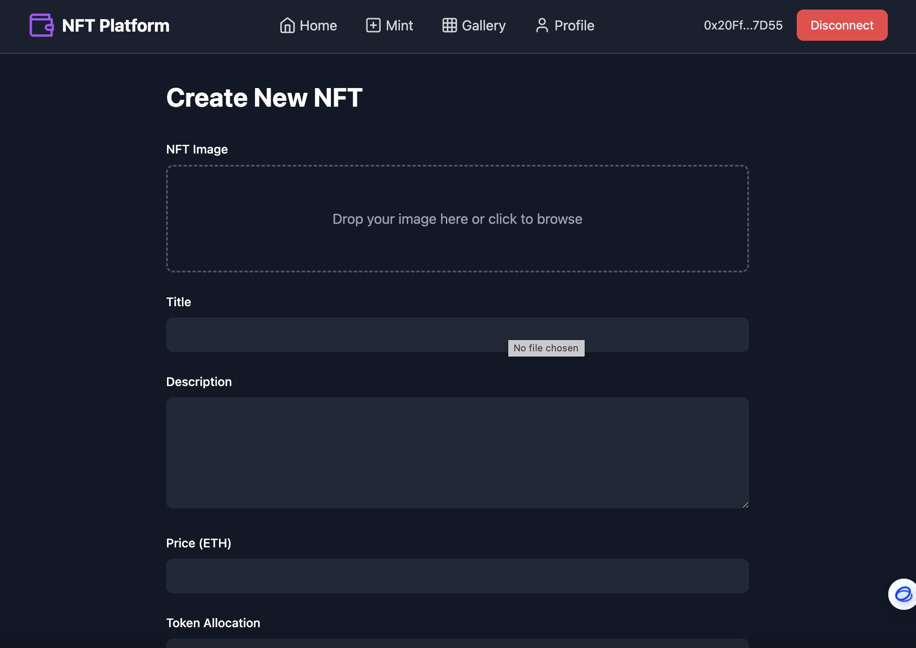
🔧NFT One-Click Minting and IP Detection

Slide 16
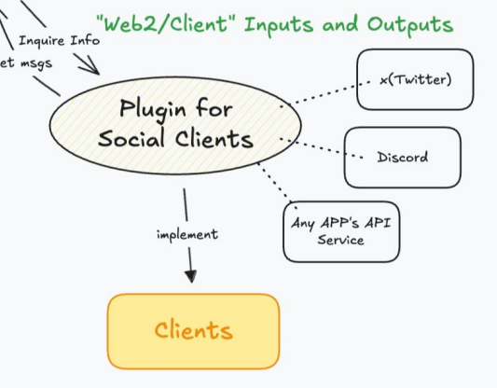
Cross-Platform Promotion with Automated Reward
Support Multi-Client

Slide 17
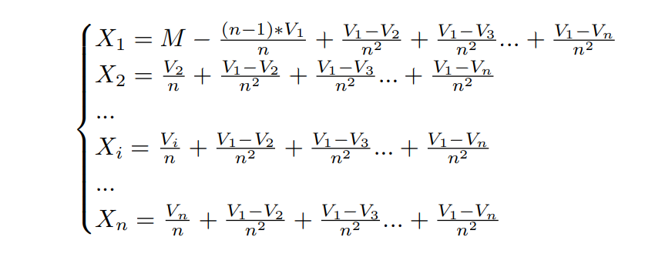
Decentralized Restructuring Algorithm
• Decentralized decision-making is a voting decision solution based on the principle of consensus agreement.
• Decentralized decision outcomes are developed based on the fair value concept.
• The fair value is determined by everyone's voting results, with values that are strategy-proof and coalition-proof.

Slide 18
Our Roadmap
From 1.0 to 3.0 – Building a Self-Running NFT World!

Slide 19
Short Term Goal
NFT Intelligent Creation
NFT One-Click Operations
NFT Contract-Based Incentives
Decentralized Restructuring

Slide 20
Mid Term Goal
Decentralized collateralized NFT transactions and decentralized price discovery mechanisms;
Ref: https://github.com/iunknow588/EthCDao/blob/master/ERCS/erc-7652.md

Slide 21
Long Term Goal
Utilizing Trusted Execution Environments (TEEs) to construct secure autonomous agent services, providing users with a decentralized decision-making voting platform, and automatically converting voting results into NFTs.

Slide 22
Our Team
Who we are？

Slide 23
Team Structure
Liu.c : Sr. Engineer , Advocate of Decentralized Decision-Making
Sam: MBA, Sr. Project Manager
Alan : AI Consultant, vibe Strategist
崔子健: UI Sr. Designer
Orion : Master of Finance , Algorithm Engineer
小军: Blockchain Engineer
李卓 : Sr. Software Engineer

Slide 24
Summary
Co create the future, starting from AIDTE！

Slide 25
Our Slogan
Collaboration and Co-Creation: Intelligent!
Decision-Making and Governance: Decentralized!
Operations and Incentives: Smart Contract!

Slide 26
Thank you!
2025/04/07
By CDAO

